Slide 1


LIFE EXPECTANCY
ANALYSIS & PREDICTION
USING MULTIPLE REGRESSOR
PREPARED & PRESENTED BY
MYTHEESH C
Analysis of data will not by itself produce new ideas....

Slide 2


TABLE OF CONTENT
CONTEXT
FEATURE UNDERSTANDING
& SELECTION
PROJECT FLOW
VISUALS ILLUSTRATION
MODEL & RESULT

Slide 3


CONTEXT
Life expectancy is a statistical measure of the average time a human being is expected to live, Life expectancy depends on various factors: Regional variations, Economic Circumstances, Sex Differences, Mental Illnesses, Physical Illnesses, Education, Year of their birth and other demographic factors.
This study provides a way to predict average life expectancy of people living in a country when various factors such as year, GDP, education, alcohol intake of people in the country, expenditure on healthcare system and some specific disease related deaths that happened in the country are given.
A typical Regression Machine Learning project leverages historical data to predict insights into the future. This study is aimed at Predicting the Life Expectancy rate of a country give various features.

Slide 4

FEATURE UNDERSTANDING
& SELECTION
The variables which we already discussed context (various factors) are taken into account of variable here. Some of the variables are,
Country
Year
Status
Life expectancy
Adult Mortality
Percentage expenditure
Diphtheria
GDP
In this project "Life expectancy" has been taken as a target variable rest of the columns containing various factors have been taken as a feature variable for target.

Slide 5

FETCH DATA FROM MySQL DATABSE
PROJECT FLOW
EDA & DATA
PRE-PROCESSING
MODELLING & EVALUATING
DEPLOY ML MODEL

Slide 6

FETCHING DATA
Fetch the data from MYSQL using the fetch() method provided by the mysql-connector-python.
Prerequisites
Username and password to connect MySQL
MySQL table name from which you want to select data.

Slide 7

EMBED POWERBI & JUPYTER
To get our Power BI analytics in a Jupyter notebook with the new powerbiclient Python package.
The new package lets you embed Power BI reports in Jupyter notebooks easily. I will be able to export data from visuals in a Power BI report to the Jupyter notebook for in-depth data exploration.
I can also filter the report for quick analysis or use bookmarks to apply a saved view.

Slide 8

VISUALS ILLUSTRATION
-STASTICAL ANALYSIS BY POWERBI
Data-set aims to answer the following key questions:
How does Infant and Adult mortality rates affect life expectancy?
Do densely populated countries tend to have lower life expectancy?
What is the impact of Immunization coverage on life Expectancy?

Slide 9
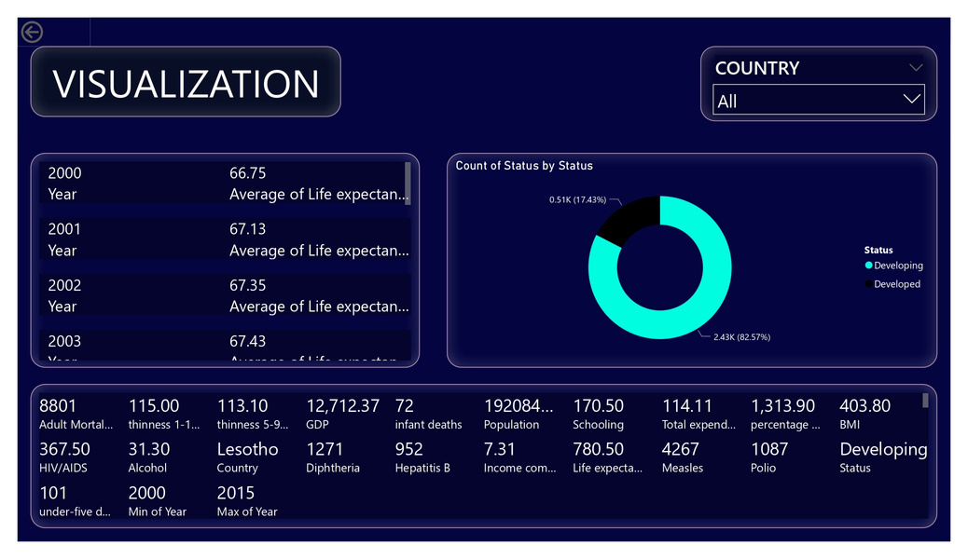
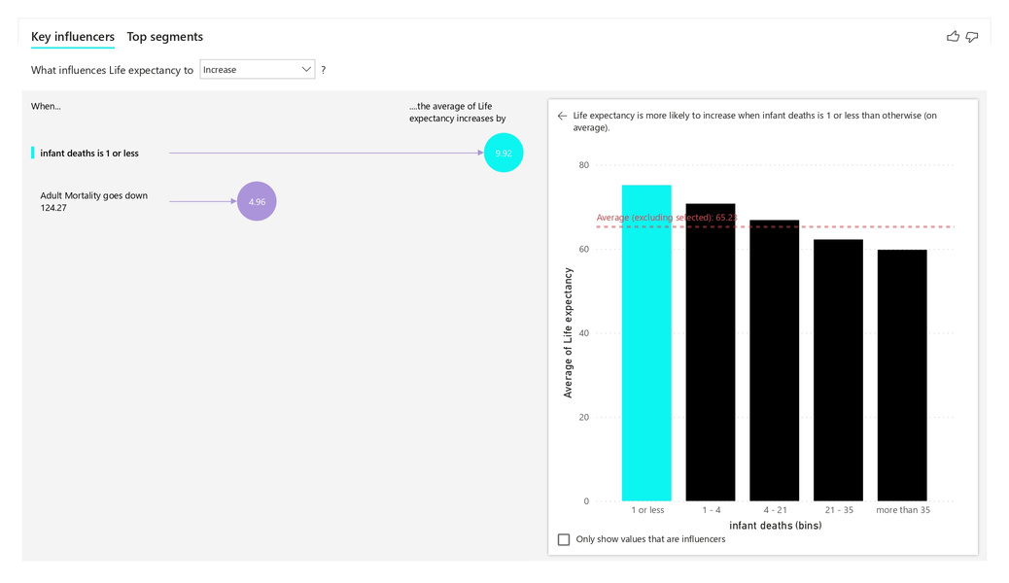
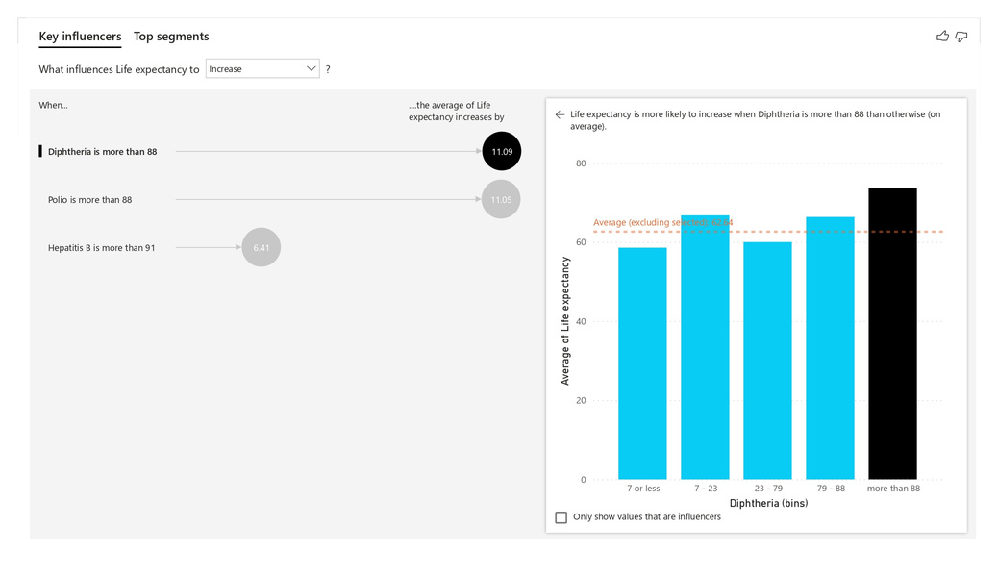
EDA VISUALIZATION

Slide 10

MODEL & RESULT
With the access of Linear Regression, Random Forest [Regressor], Decision Tree [Regressor] are various algorithms where used to predict the data and are evaluated by R square , Mean Absolute Error and Mean Square Error method.
Accuracy Comparison are made between those three model.
Apart from these Algorithms there are some other resource that are being used here such as RandomizedSearchCV for hyperparameter tuning [Random forest regressor].
Besides we find the feature importance of the model and plot feature importance graph.

Slide 11
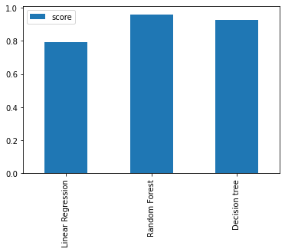

MODEL COMPARISION
MODEL SCORE
Linear Regression: 0.7946281268985743
Random Forest: 0.9606835446908324
Decision tree: 0.9295401567406675

Slide 12
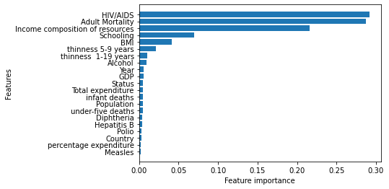

FEATURE IMPORTANCE

Slide 13






DEPLOY MODEL
To create a predictor model of web UI.Best model [RandomForest] will be deployed by using Flask.
BEST ML MODEL
FLASK SERVER
Send the predicted label to the web page
Send query to flask
WEB PAGE
Text Query From the user

Slide 14
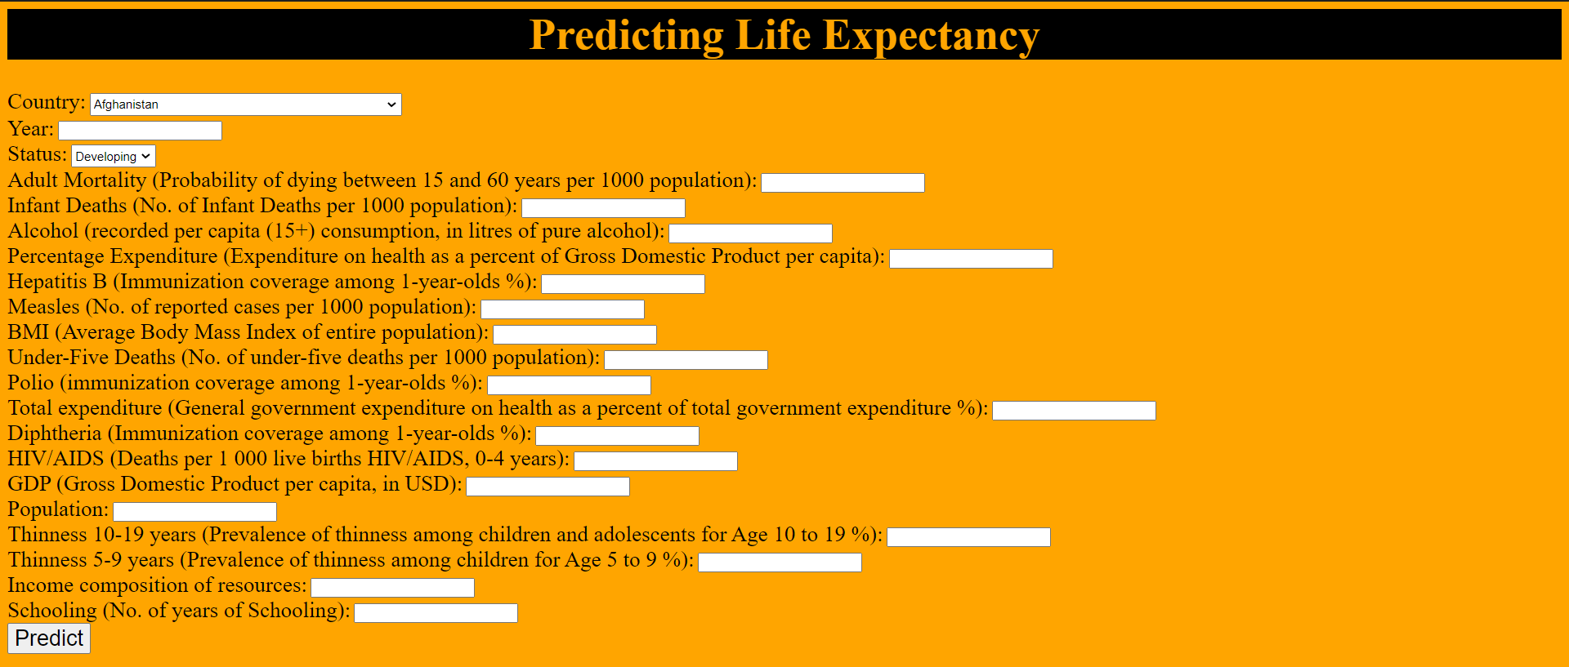
WEB-UI

Slide 15


CONCLUSION
The prediction model is trained using three regression models, namely Linear Regression, Decision Tree Regressor and Random Forest Regressor. The selection of model is done on the basis of R 2 score, Mean Squared Error & Mean Absolute Error. Random Forest Regressor is selected for the development of the prediction model for life expectancy and the comparative analysis of life expectancy between developed and developing countries suggests that, developed countries have high life expectancy as compared to developing countries.

Slide 16

Thank you!

